Slide 1
What is Azure?
Cloud Concepts
Type of Clouds
Agenda
IaaS, Paas, Saas
Difference between on-premises & cloud-based
Job responsibilities as Azure Data Engineer
Types of Data
Knowledge Check

Slide 2

Skills measured
Design and implement data storage (40-45%)
Design and develop data processing (25-30%)
Design and implement data security (10-15%)
Monitor and optimize data storage and data processing (10-15%)

Slide 3
Job responsibilities as Azure Data Engineer
Integrating, transforming, and consolidating data from various structured and unstructured data systems into a structure that is suitable for building analytics solutions.
Azure Data Engineers help stakeholders understand the data through exploration, and they build and maintain secure and compliant data processing pipelines by using different tools and techniques. These professionals use various Azure data services and languages to store and produce cleansed and enhanced datasets for analysis.
Azure Data Engineers also help ensure that data pipelines and data stores are high-performing, efficient, organized, and reliable, given a set of business requirements and constraints. They deal with unanticipated issues swiftly, and they minimize data loss. They also design, implement, monitor, and optimize data platforms to meet the data pipelines needs.

Slide 4
Job responsibilities as Azure Data Engineer
Extract, Load, and Transform (ELT)
Extract, Transform, and Load (ETL).
Change data processes
Move from implementing to provisioning servers
Work on different data model
Design Data architecture
Work on different layer for Data modeling
Deal with different domain data

Slide 5

What is Azure?
Cloud computing platform with an ever-expanding set of services to help you build solutions to meet your business goals.
Azure services range from simple web services for hosting your business presence in the cloud to running fully virtualized computers for you to run your custom software solutions.
A wealth of cloud-based services like remote storage, database hosting, and centralized account management. Azure also offers new capabilities like AI and Internet of Things (IoT).
Azure gives you the freedom to build, manage, and deploy applications on a massive global network using your favorite tools and frameworks.

Slide 6
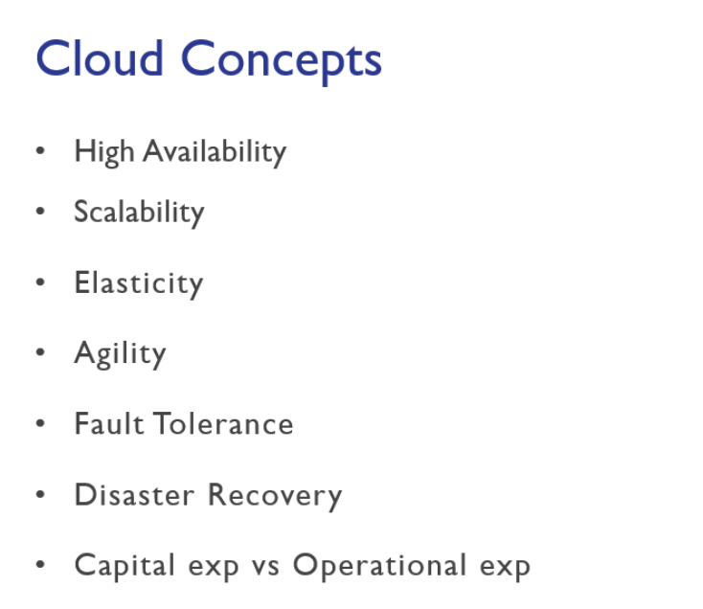
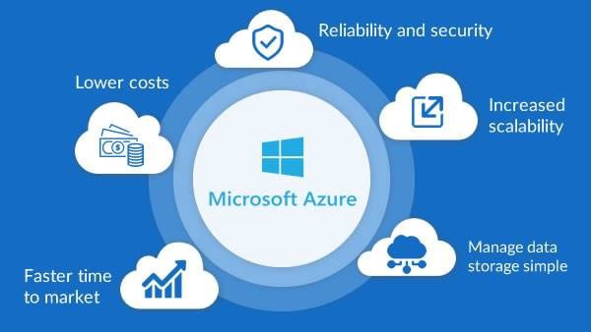

Slide 7
High Availability
Expressed as a percentage, it’s the ability of a system to respond to users

Slide 8
Scalability
The ability of a system to handle growth of users or work

Slide 9
App failure
Max capacity
Number of concurrent users

Slide 10
Elasticity
The ability of a system to automatically grow and shrink based on application demand

Slide 11
capacity
User demand

Slide 12
Fault Tolerance
The ability of a system to handle faults like power, networking, or hardware failures

Slide 13
Disaster Recovery
The ability of a system to recover from failure within a period of time, and how much data is lost

Slide 14
Economies of Scale
It’s cheaper for Microsoft to run a server than you can ever achieve yourself

Slide 15
Capital Expenditure (CapEx) & Operational Expenditure (OpEx)
CapEx is money invested in assets (like computers) that return investment over time
OpEx is money spent every day on operating expenses

Slide 16
Consumption-Based Model
Pay per minute
Pay per hour
Pay per execution

Slide 17
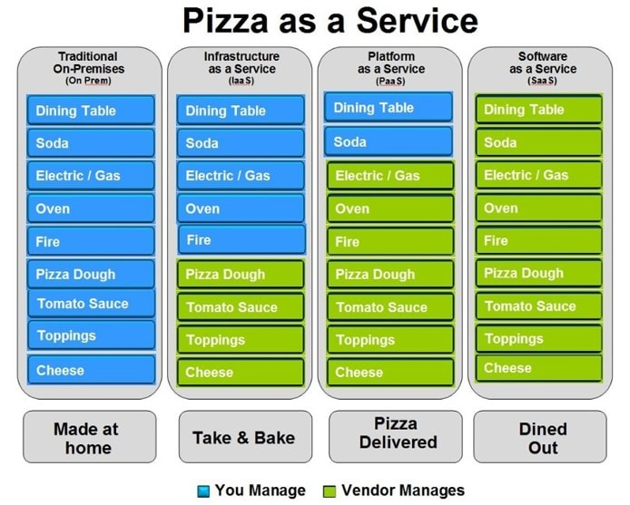

Slide 18
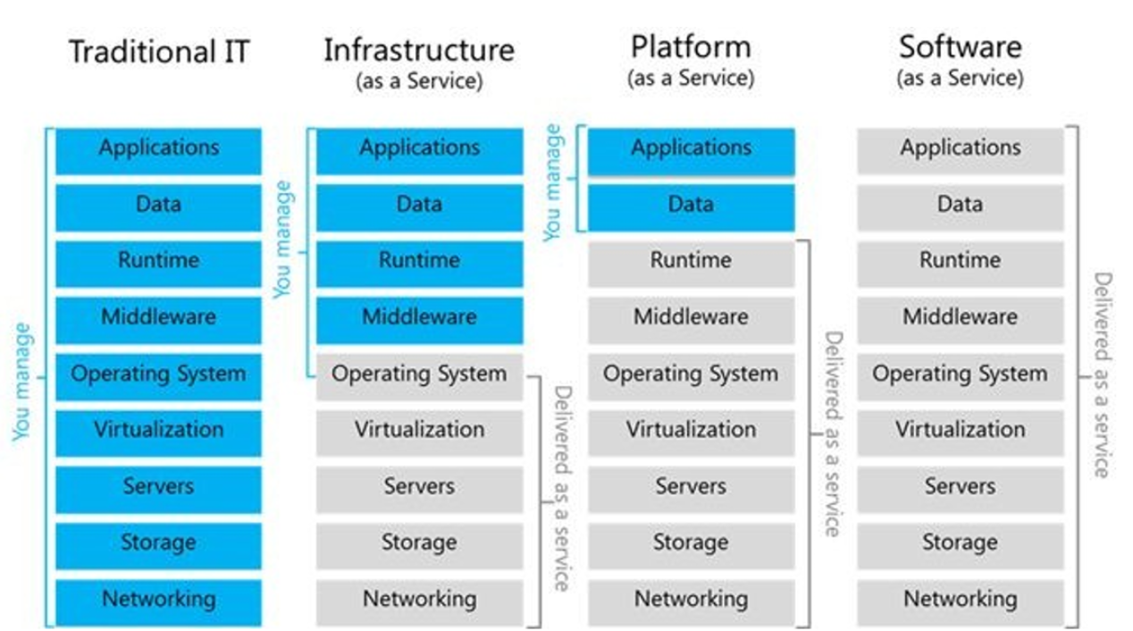

Slide 19
Infrastructure-as-a- Service (IaaS)
Virtual machines, networking, load balancers, ﬁrewalls

Slide 20
Platform-as-a-Service (PaaS)
Upload code packages and have them run, without access to the hardware

Slide 21
Software-as-a-Service (SaaS)
Access to conﬁguration only

Slide 22
Public cloud
Computing services offered over the public Internet; anyone can sign up

Slide 23
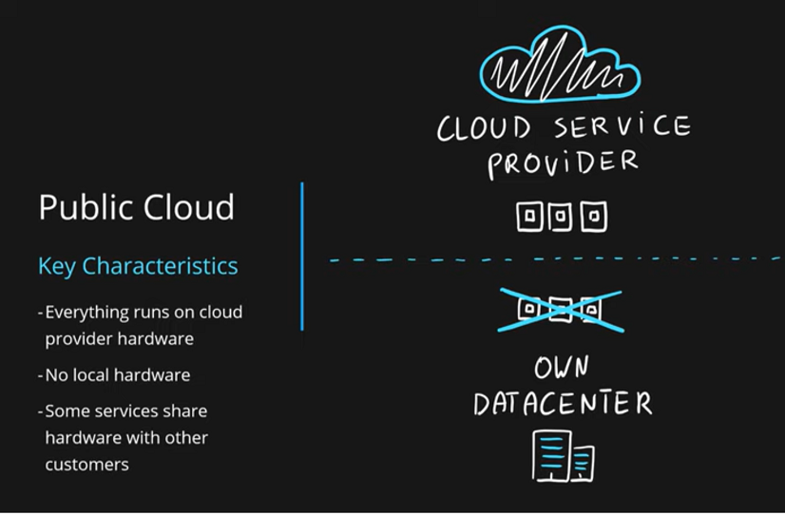

Slide 24
Private cloud
Computing services offered to only select users; internal or corporate cloud

Slide 25
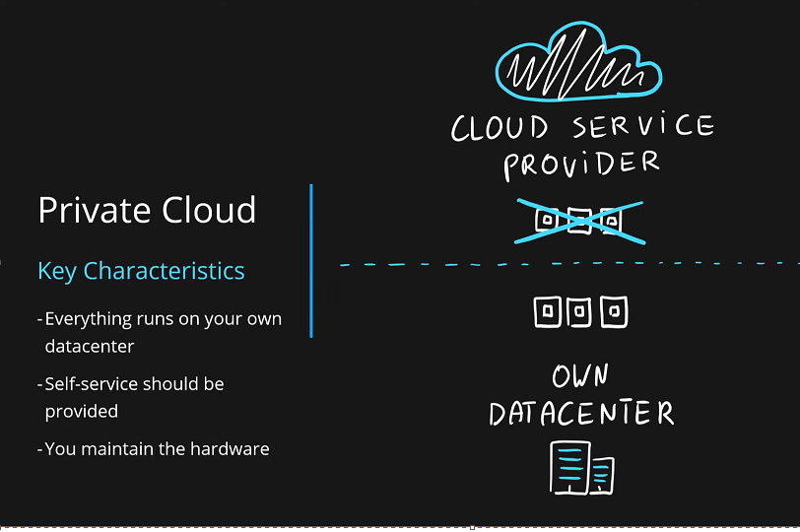

Slide 26
Hybrid cloud
Combination of public and private clouds; scale private infrastructure to the cloud

Slide 27
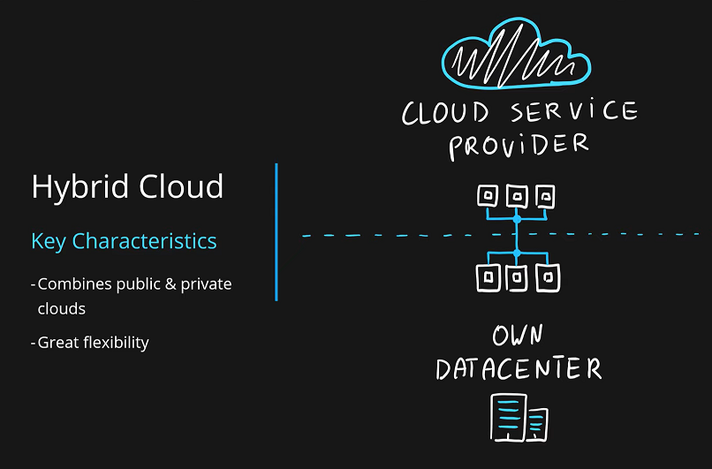

Slide 28
Understand the difference between on-premises and cloud-based servers
 | On-premises | Cloud
Computing Licensing | Physical servers, network infrastructure, and storage | Provide everything to their subscribers.
Maintenance | maintenance for the hardware, software, and antivirus software. | Microsoft manages key infrastructure
Scalability | Add another server node to a cluster a hardware load balancer | scalability in the cloud is measured in compute units & as simple as a mouse click.
Availability | On-premises servers, the more uptime the SLA requires, the higher the cost. | Azure duplicates customer content for redundancy and high availability.
Support | Server administrators & Software, Hardware knowledge | When Microsoft updates a product, the update applies to all consumers of the product.
Total cost of ownership | on-premises server systems are very expensive, costs are often capitalized. | Azure track costs by subscriptions.

Slide 29
54
Regions - not all accessible by everyone

Slide 30
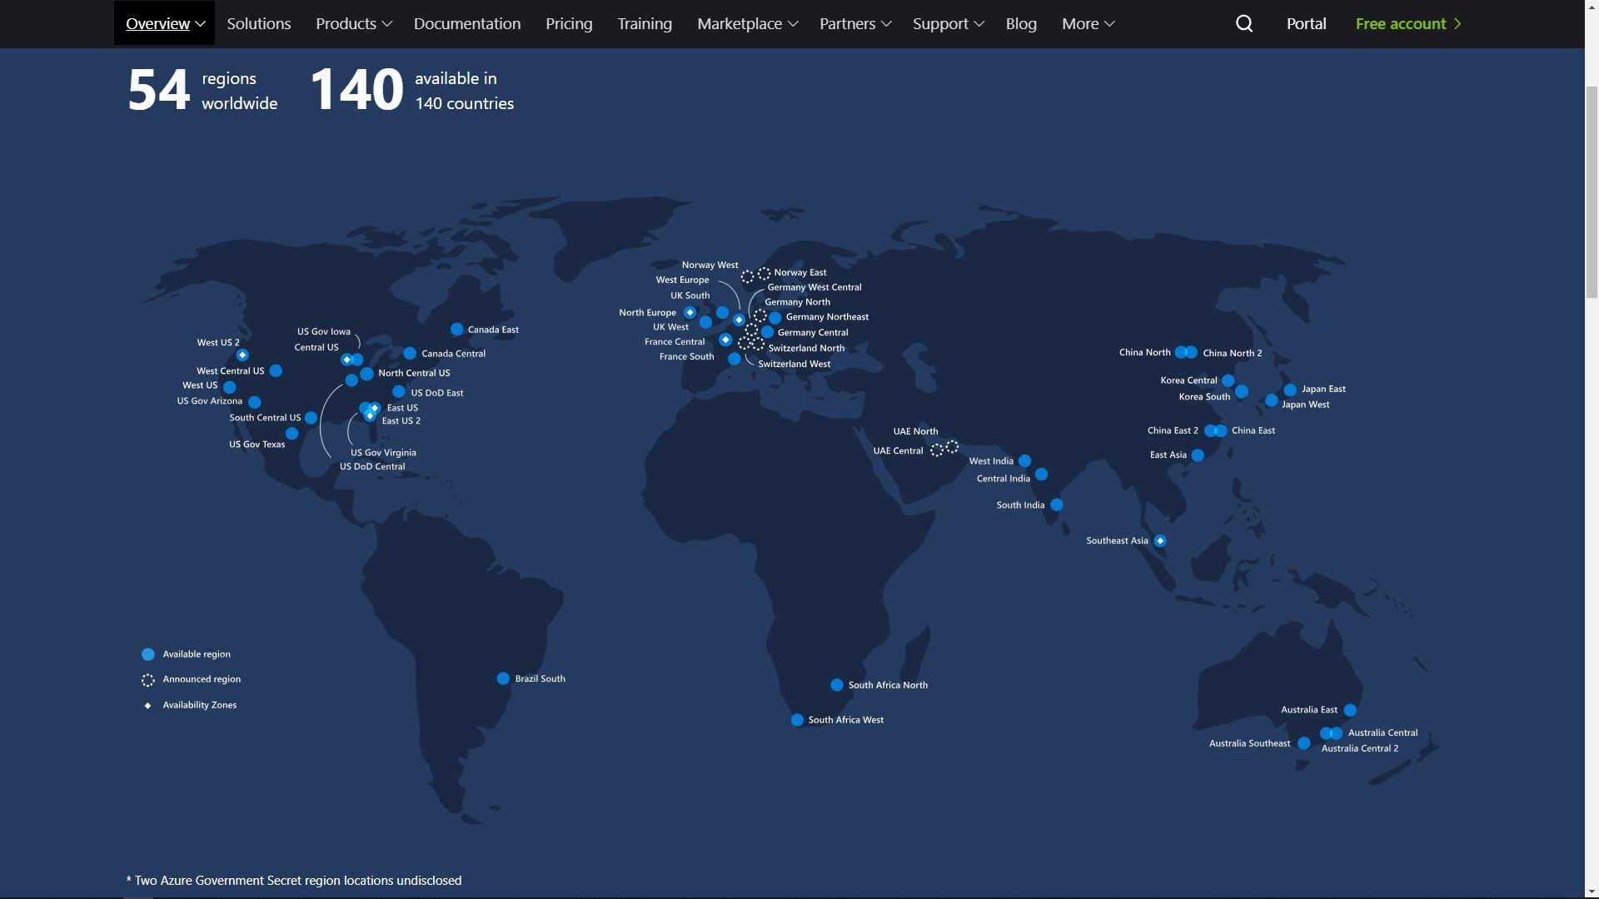

Slide 31
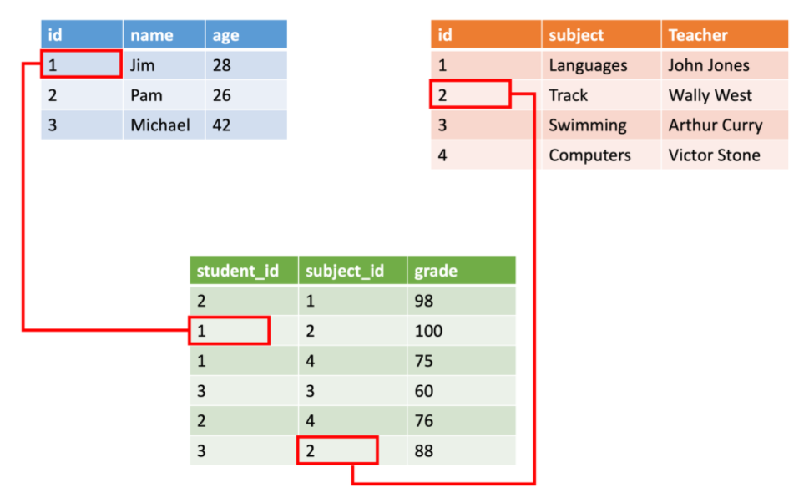



Types of Data
Structured
Unstructured Streaming
“ ”
Structured data : relational data, is straightforward in that it's easy to enter, query, and analyze
Semi-structured data : non-relational or NoSQL ,contains tags that make the organization and hierarchy of the data apparent - for example, key/value pairs. XML, JSON, YAML
Unstructured data: The organization of unstructured data is ambiguous. Examples of unstructured data include: Log file, media file, Text file

Slide 32
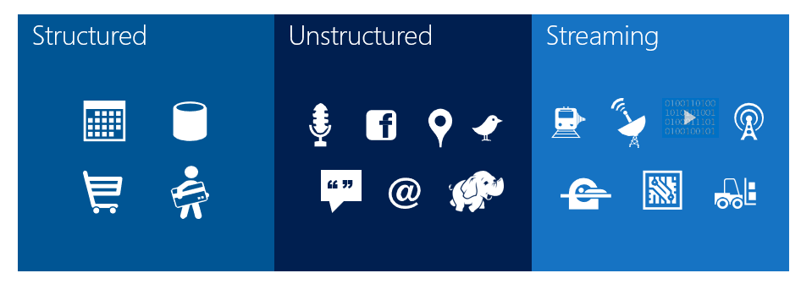
Structured
Unstructured Streaming
“ ”

Slide 33
Knowledge Check
1. Which data processing framework will a data engineer use to ingest data onto cloud data platforms in Azure?
Online transaction processing (OLTP)
Extract, transform, and load (ETL)
Extract, load, and transform (ELT)
2. The schema of what data type can be defined at query time?
Structured data
Azure Cosmos DB
Unstructured data

Slide 34
Knowledge Check
1. Which data processing framework will a data engineer use to ingest data onto cloud data platforms in Azure?
Online transaction processing (OLTP)
Extract, transform, and load (ETL)
Extract, load, and transform (ELT)
2. The schema of what data type can be defined at query time?
Structured data
Azure Cosmos DB
Unstructured data

